Slide 1
FASTA/FASTQ Parser and Sequence Analysis in Python
By Gopalakrishnan Kumar, MTech IIT-Bombay,
Consultant Data Scientist
LinkedIn: Profile Link : https://www.linkedin.com/in/gopalakrishnankumar-a73301110/
Github:https://github.com/Gopal21236/
Kaggle URL- https://www.kaggle.com/gopalkk2

Slide 2
Google Colab URL
https://colab.research.google.com/drive/1pIJcUXCMNKPLGby7s2D7Z6-j7bcxTsvc?usp=sharing

Slide 3
Abstract
This project develops a Python-based FASTA/FASTQ parser for processing synthetic biological sequence files. The system automatically identifies FASTA or FASTQ input, extracts sequence identifiers, descriptions, nucleotide sequences and, for FASTQ files, quality strings. It then performs sequence validation, length analysis, nucleotide composition, GC-content calculation and basic quality-score analysis. Visualization is performed using histogram, bar-chart, stacked-bar-chart and a combined stacked-bar plus GC-content plot. The project demonstrates a practical end-to-end bioinformatics workflow from sequence-file input to interpretable analytical output.

Slide 4
Introduction
FASTA and FASTQ are widely used text-based formats for storing biological sequence data. FASTA is commonly used for nucleotide or protein sequences, while FASTQ additionally stores per-base sequencing quality information. A parser converts these structured text records into Python objects that can be analyzed computationally. In this project, synthetic DNA sequences are used so that the complete workflow can be reproduced without requiring confidential or real sequencing data.

Slide 5
Objectives
Build a Python parser capable of reading FASTA and FASTQ files.
Automatically detect the input sequence-file format.
Extract sequence IDs, descriptions, sequences and FASTQ quality strings.
Validate DNA sequences and identify invalid characters.
Calculate sequence length, total bases, minimum, maximum and average length.
Calculate A, C, G and T nucleotide composition and GC content.
Convert FASTQ quality characters to Phred scores.
Generate synthetic FASTA and FASTQ datasets.
Create histogram, bar-chart and stacked-bar visualizations.
Create a combined stacked-bar chart with a GC-content line.

Slide 6
FASTA Format
A FASTA record begins with a greater-than symbol (>) followed by an identifier and optional description. The following lines contain the sequence. A sequence may span multiple lines.
>SEQ001 Human_Gene_1
ATGCGTACGTAGCTAGCTAGCTAGCTAG

Slide 7
FASTQ Format
A FASTQ record normally contains four logical lines: a header beginning with @, the nucleotide sequence, a separator line beginning with +, and a quality string. The quality string contains one quality character per base.
@READ001 Sample_A
ATGCGTACGTAGCTAG
+
IIIIIIIIIIIIIIII

Slide 8
Synthetic Dataset
The project uses synthetic DNA sequences composed of A, C, G and T. A reproducible random seed can be used to generate a larger dataset, for example 50 or 100 sequences with lengths selected from a defined range. The generated records can be written to both FASTA and FASTQ files. Synthetic data are useful for testing parser logic, plotting and validation without depending on an external biological dataset.
Record | Format | Sequence | Purpose
SEQ001 | FASTA | ATGCGTACGTAGCTAG... | Synthetic gene
SEQ002 | FASTA | ATGCCGATCGATCGTA... | Synthetic gene
SEQ003 | FASTA | ATGAAACCCGGGTTTA... | Synthetic gene
READ001 | FASTQ | ATGCGTACGTAGCTAG | Synthetic read

Slide 9
System Workflow
Input file → format detection → parsing → sequence records → validation → statistics → nucleotide composition → GC content / quality analysis → visualization → interpretation.

Slide 10
Python Implementation
The core implementation uses Python's built-in file handling and dataclass support together with collections.Counter for nucleotide counts and Matplotlib for visualization. The following code provides a compact, self-contained implementation suitable for Google Colab or Jupyter.

Slide 11
Sequence Statistics
For every parsed record, the sequence length is obtained directly from the number of bases. Across the dataset, total bases, minimum length, maximum length and average length can be calculated. These metrics provide an initial quality-control summary.
Average sequence length = Total number of bases / Number of sequences

Slide 12
Nucleotide Composition
The nucleotide composition counts the occurrences of A, C, G and T. The sum of these counts equals the sequence length for sequences containing only the four standard DNA bases.
Nucleotide composition is useful for detecting unusual sequence composition and for comparing different synthetic or experimental sequence groups.

Slide 13
GC Content
GC content is the percentage of bases that are either guanine (G) or cytosine (C).
GC% = ((Number of G + Number of C) / Total sequence length) × 100

Slide 14
FASTQ Quality Analysis
FASTQ quality characters can be converted to Phred scores using the standard Sanger/Illumina 33-style offset when that encoding is appropriate. For a quality character q, the Phred score is calculated as ord(q) − 33. Higher Phred scores represent higher base-call confidence.

Slide 15
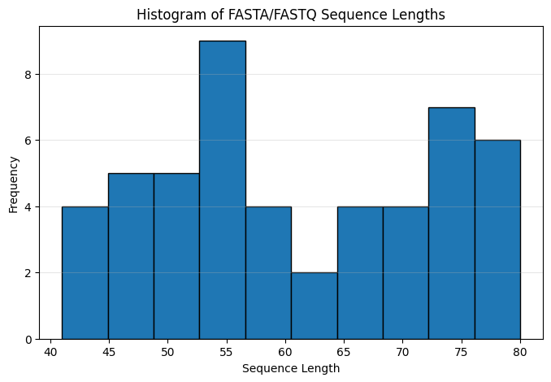
Data Visualization

Slide 16
Histogram Plot
FASTQ quality characters can be converted to Phred scores using the standard Sanger/Illumina 33-style offset when that encoding is appropriate. For a quality character q, the Phred score is calculated as ord(q) − 33. Higher Phred scores represent higher base-call confidence.

Slide 17
Bar Chart Plot
A bar chart compares the length of individual sequence records. Sequence IDs are placed on the x-axis and sequence length in base pairs on the y-axis. This makes unusually short or long records easy to identify.

Slide 18
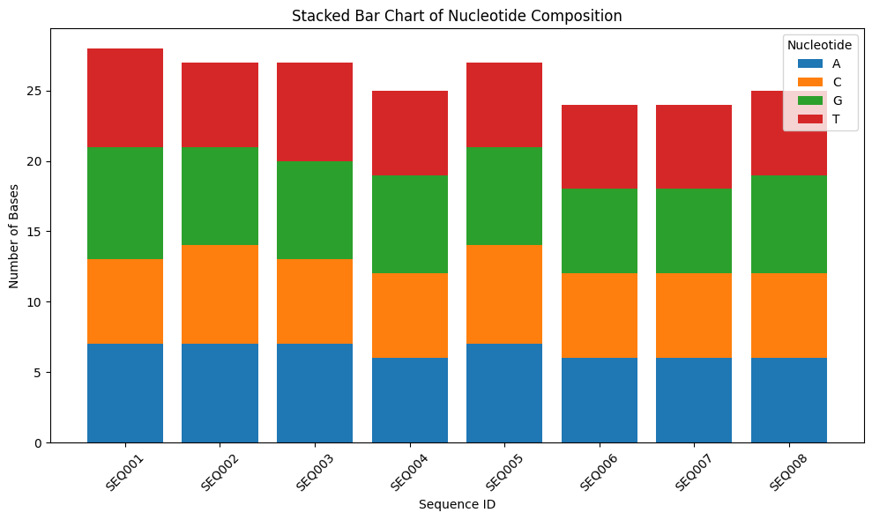
Data Visualization

Slide 19
Stacked Bar Chart
The stacked bar chart displays A, C, G and T counts within the same bar for every sequence. The full bar height represents the total sequence length, while its segments show the contribution of each nucleotide.

Slide 20
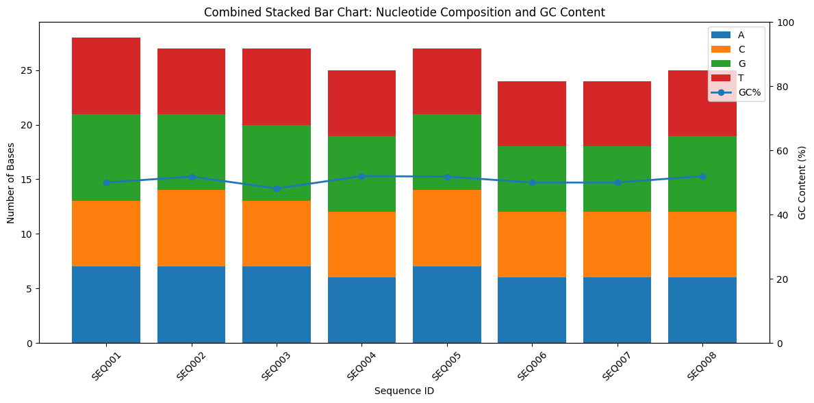
Data Visualization

Slide 21
Combined Stacked Bar Chart + GC%
The combined visualization places A/C/G/T counts in stacked bars and overlays a GC-percentage line using a secondary y-axis. This allows sequence size/composition and GC variation to be examined in one figure.

Slide 22
Expected Output
Parsed FASTA/FASTQ records with identifiers and sequences.
Number of sequences and total number of bases.
Minimum, maximum and average sequence lengths.
DNA validation results.
A/C/G/T nucleotide counts.
GC percentage for every sequence.
FASTQ mean quality where quality data are available.
Histogram of sequence lengths.
Bar chart of sequence lengths by record.
Stacked bar chart of nucleotide composition.
Combined stacked-bar and GC% visualization.

Slide 23
Interpretation
The histogram summarizes the overall length distribution, whereas the individual bar chart identifies record-level differences. The stacked bar chart reveals the nucleotide composition of each sequence. The GC% line provides a compact comparison of GC enrichment across records. Together, these plots provide complementary views rather than duplicating the same information.

Slide 24
Error Handling and Validation
FASTA headers are checked using the > character.
FASTQ headers are checked using the @ character.
The FASTQ separator line must begin with +.
FASTQ sequence and quality strings must have equal lengths.
DNA validation identifies characters outside A, C, G, T and optional N.
Empty records and malformed input should be handled explicitly in production applications.

Slide 25
Applications
Educational bioinformatics and Python programming.
Sequence-file quality control.
Preprocessing for downstream sequence analysis.
Synthetic-data testing of bioinformatics pipelines.
Basic genomic and metagenomic exploratory analysis.
Preparation of sequence statistics for reports and dashboards

Slide 26
Limitations
This project is intentionally a basic parser and analytical workflow. It does not perform alignment, variant calling, read trimming, adapter detection, genome assembly or biological annotation. FASTQ quality interpretation also depends on the actual quality-score encoding used by the source instrument or pipeline. Synthetic data demonstrate the software workflow but should not be interpreted as biological evidence.

Slide 27
Future Enhancements
Support compressed .gz FASTA/FASTQ files.
Process very large files in a streaming manner.
Add reverse-complement and DNA-to-protein translation.
Add codon-frequency analysis.
Add N50 and other assembly statistics.
Add quality trimming and low-quality read filtering.
Export results to CSV/Excel.
Build an interactive Streamlit dashboard.
Add command-line arguments for input/output files.
Add automated unit tests for malformed FASTA/FASTQ records.

Slide 28
Conclusion
The FASTA/FASTQ parser project demonstrates how Python can be used to transform structured sequence files into analyzable biological records. The workflow combines parsing, validation, sequence statistics and visualization. The synthetic dataset makes the project reproducible and suitable for demonstrations, coursework and development of a larger bioinformatics pipeline. The combined stacked-bar and GC-content plot provides a particularly useful summary of sequence composition while the histogram and bar chart describe sequence-length variation.

Slide 29
Suggested Project Structure
FASTA_FASTQ_Project/
├── synthetic_sequences.fasta
├── synthetic_sequences.fastq
├── fasta_fastq_parser.py
├── sequence_analysis.py
├── plots.py
└── README.md

